Slide 1

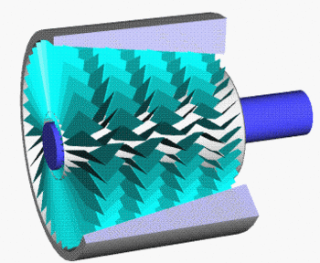
AXIAL FLOW COMPRESSOR
UNDER THE CONTINUOUS GUIDAINCE OF : PROF. PRASHANT THAKAR
Presented by
PC-11 Shaunak Kolhe
PC-19 Sarvesh Mahadevan
PC-42 Prathamesh Kumbhar
PC-46 Saumitra Mahajan

Slide 2
Introduction
4
An axial compressor is a machine that can continuously pressurize gases. It is a rotating, air foil-based compressor in which the gas or working fluid principally flows parallel to the axis of rotation.
Axial flow compressors produce a continuous flow of compressed gas and have the benefits of high efficiency and large mass flow rate, particularly in relation to their size and cross-section.
They do, however, require several rows of air foils to achieve a large pressure rise, making them complex and expensive relative to other designs.
Axial compressors are integral to the design of large gas turbines such as jet engines, high speed ship engines, and small-scale power stations

Slide 3
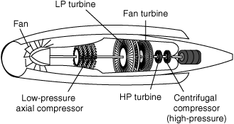
They are also used in industrial applications such as large volume air separation plants, blast furnace air, fluid catalytic cracking air, and propane dehydrogenation.
Due to high performance, high reliability and flexible operation during the flight envelope, they are also used in aerospace engines.
5

Slide 4
Construction
6
Axial flow compressor consists of casing fitted with several rows of fixed blades & several rows of moving blades which are attached on rotor as shown in fig. The fixed blades are placed on alternative rows. The fixed blades & moving blades are as possible for efficient flow.
The one set of rotor blades & one set of stator blades called stage. The number of stages in axial flow compressor depends upon pressure ratio required. Usually 5 to 14 stages are used
The length of blades is reduced in direction of flow to compensate for the reduction in volume resulting from the increased pressure.
The blades are so arranged that the spaces between blades form diffuser passage& hence velocity of air is reduced as it passes through them & pressure increases

Slide 5
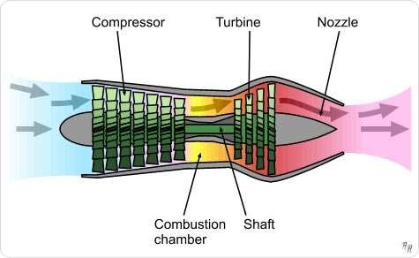
Axial flow compressor is also high speed machine & speed may even vary from 10000 to 30000 RPM.
Generally, maximum pressure ratio achieved in a stage of axial compressor is about 1.12 to 1.2, hence to obtain pressure ratio of 12, attainable by axial flow compressor 15 to 20 stages are required.
7

Slide 6
Working
8
As the fluid enters and leaves in the axial direction, the centrifugal component in the energy equation does not come into play. Here the compression is fully based on diffusing action of the passages.
The diffusing action in stator converts absolute kinetic head of the fluid into rise in pressure. The relative kinetic
head in the energy equation is a term that exists only because of the rotation of the rotor.
The rotor reduces the relative kinetic head of the fluid and adds it to the absolute kinetic head of the fluid i.e., the impact of the rotor on the fluid particles increases its velocity (absolute) and thereby reduces the relative velocity between the fluid and the rotor.
In short, the rotor increases the absolute velocity of the fluid and the stator converts this into pressure rise

Slide 7
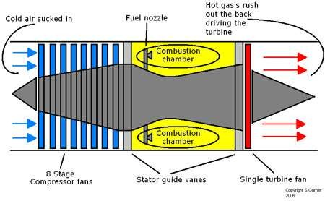
9
Designing the rotor passage with a diffusing capability can produce a pressure rise in addition to its normal functioning.
This produces greater pressure rise per stage which constitutes a stator and a rotor together. This is the reaction principle in turbo machines. If 50% of the pressure rise in a stage is obtained at the rotor section, it is said to have a 50% reaction.

Slide 8
Design
10
The increase in pressure produced by a single stage is limited by the relative velocity between the rotor and the fluid, and the turning and diffusion capabilities of the air foils.
A typical stage in a commercial compressor will produce a pressure increase of between 15% and 60% at design conditions with a polytrophic efficiency in the region of 90–95%.
To achieve different pressure ratios, axial compressors are designed with different numbers of stages and rotational speeds. As a general rule-of-thumb we can assume that each stage in a given compressor has the same temperature rise (δT).
Therefore, at the entry, temperature (Tstage) to each stage must increase progressively through the compressor and the ratio (δT)/(Tstage) entry must decrease, thus implying a progressive reduction in stage pressure ratio through the unit. Hence the rear stage develops a significantly lower pressure ratio than the first stage.

Slide 9
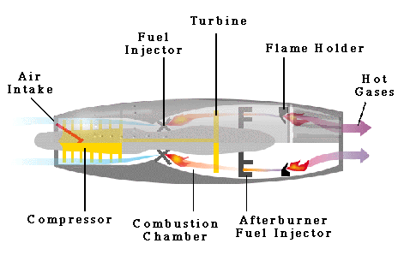
11
Higher stage pressure ratios are also possible if the relative velocity between fluid and rotors is supersonic, but this is achieved at the expense of efficiency and operability.
Such compressors, with stage pressure ratios of over 2, are only used where minimizing the compressor size, weight or complexity is critical, such as in military jets.

Slide 10
Main Parts
12
Following are two main elements of an axial flow compressor,
Rotor.
Stator.
The rotor is the rotating element of the compressor. The stator is fixed element of compressor. The rotor & stator are enclosed in a compressor case.
The rotor has a fixed blades that force the air rearward much like an aircraft propeller. In front of first rotor stage are inlet guide vanes. These vanes direct the intake air toward the first set of rotor blades directly behind each rotor stage is a stator.

Slide 11
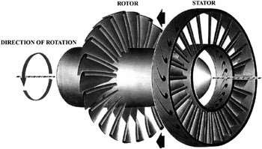
13
The stator directs the air rearward to the next rotor stage. Each consecutive pair of rotor & stator blades constitutes a pressure stage.
Main Parts

Slide 12
Stalling of Axial Flow Compressor
14
◆ Stalling is an important phenomenon that affects the performance of the compressor. An analysis is made of rotating stall in compressors of many stages, finding conditions under which a flow distortion can occur which is steady in a traveling reference frame, even though upstream total and downstream static pressure are constant.
◆ In the compressor, a pressure-rise hysteresis is assumed.
◆ It is a situation of separation of air flow at the aero-foil blades of the compressor. This phenomenon depending upon the blade-profile leads to reduced compression and drop in engine power.

Slide 13
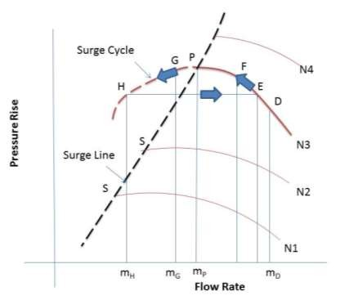
Surging
◆ In the plot of pressure-flow rate the line separating graph between two regions- unstable and stable is known as the Surge Line.
◆ This line is formed by joining surge points at different rpms. Unstable flow in axial compressors due to complete breakdown of the steady through flow is term as surging. This phenomenon affects the performance of compressor and is undesirable.
◆ Surge cycle Suppose the initial operating point D at some rpm N. On decreasing the flow- rate at same rpm along the characteristic curve by partial closing of the valve, the pressure in the pipe increases which will be taken care by increase in input pressure at the compressor.
15

Slide 14
Surging
◆ Further increase in pressure till point P (surge point), compressor pressure will increase. Further moving towards left keeping rpm constant, pressure in pipe will increase but compressor pressure will decrease leading to back air-flow towards the compressor
◆ Due to this back flow, pressure in pipe will decrease because this unequal pressure condition cannot stay
for a long period of time.
◆ Though valve position is set for lower flow rate say point G but compressor will work according to normal stable operation point say E, so path E-F-P-G-E will be followed leading to breakdown of flow, hence pressure in the compressor falls further to point H.
16

Slide 15
17
This phenomenon will cause vibrations in the whole machine and may lead to mechanical failure. That is why left portion of the curve from the surge point is called unstable region and may cause damage to the machine. So the recommended operation range is on the right side of the surge line.
Surging

Slide 16
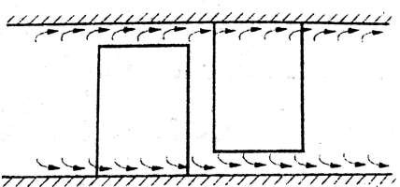
Stage losses in Axial Flow Compressor
18
Profile Loss: - This loss occurs due to growth of boundary layer & it separation on blade profile. Separation of boundary layer occurs when adverse pressure gradient on surface becomes too steep, this increases profile loss.
Annulus Loss: - It is friction loss & occurs due to compressor annulus walls friction as shown in fig. Due to friction the pressure loss increases.

Slide 17
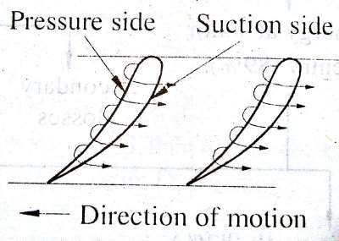
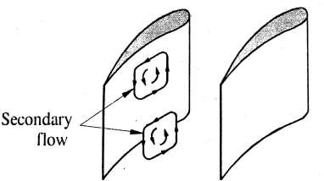
Stage Losses
19
3. Secondary Loss: - This loss occurs due to secondary flows in blades passage as shown in fig. In axial flow compressor certain secondary flows are produced by combined effect of curvature & boundary layer. It is produced when a stream-wise component of velocity is developed from deflection of an initially sheared flow.
4.Tip Leakage Loss: - Tip clearance between blades & casing causes leakage of fluid from pressure side to suction side of blades as shown in fig. Therefore scraped up boundary layer of casing increases tip leakage & generates additional secondary flow.

Slide 18
Advantages of
21
High peak efficiency.
Small frontal area for given flow.
Straight through flow, allowing high ram efficiency.
Increased pressure rise due to increased number of stages with negligible losses.
Axial Flow
Compressor​

Slide 19
Disadvantages of Axial Flow Compressor
22
Good efficiency over narrow rotational speed range.
Manufacturing is difficult.
Cost is very high.
Heavy weight.
High starting power requirements.

Slide 20
Application of Axial flow compressor
23
Blast furnaces.
Air separation plants.
Fluid catalytic cracking units.
Nitric acid plants.
Jet-engine test facilities.

